Slide 1
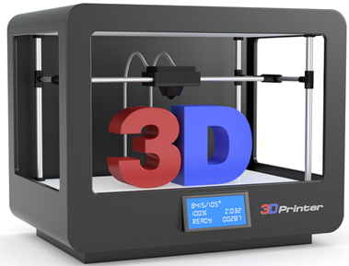
3D Printing
Day 1
(Grade 6+)

Slide 2
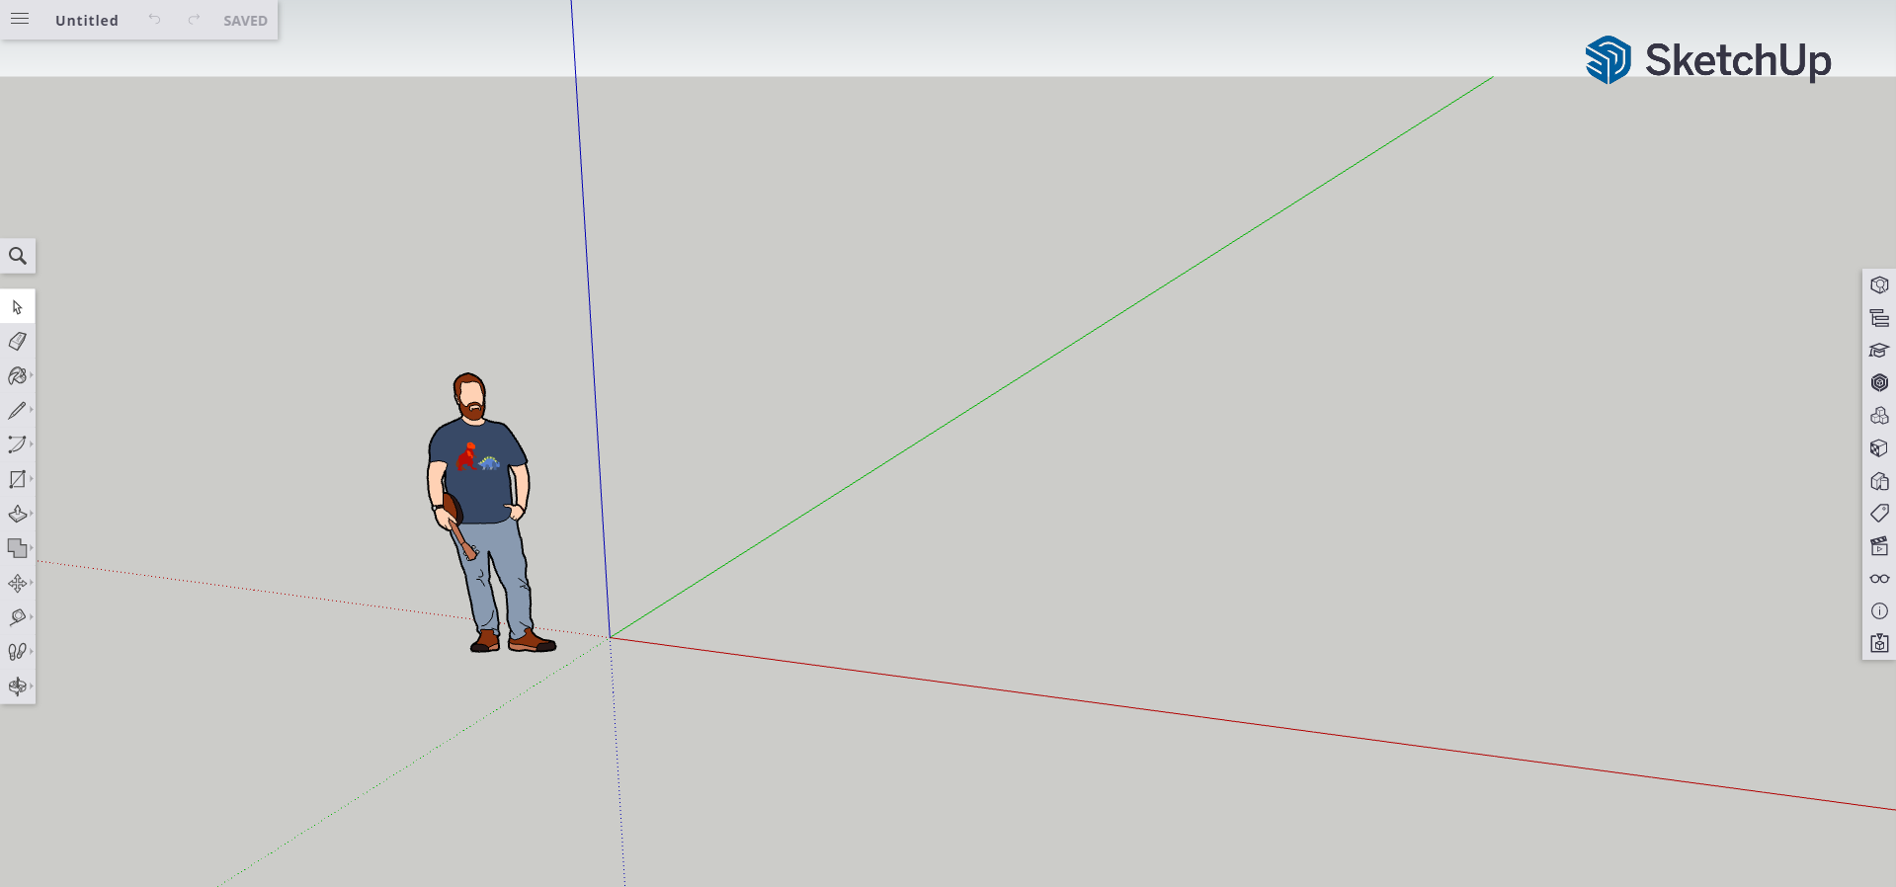
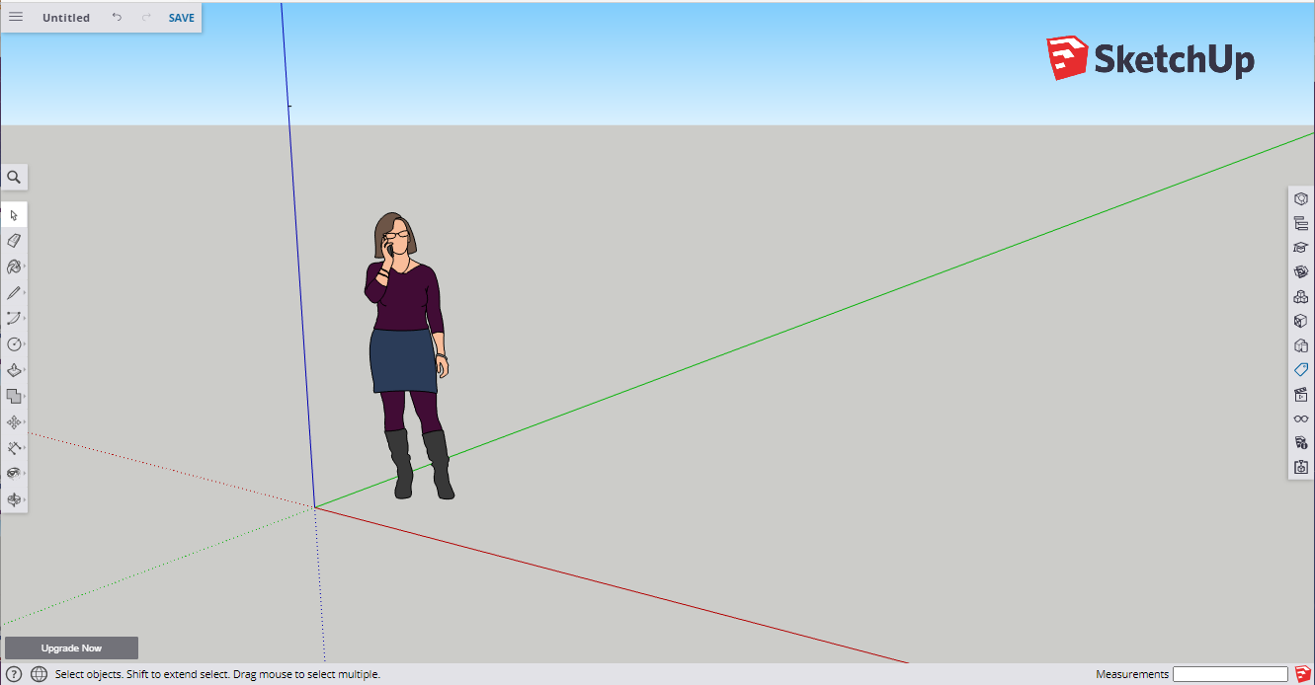
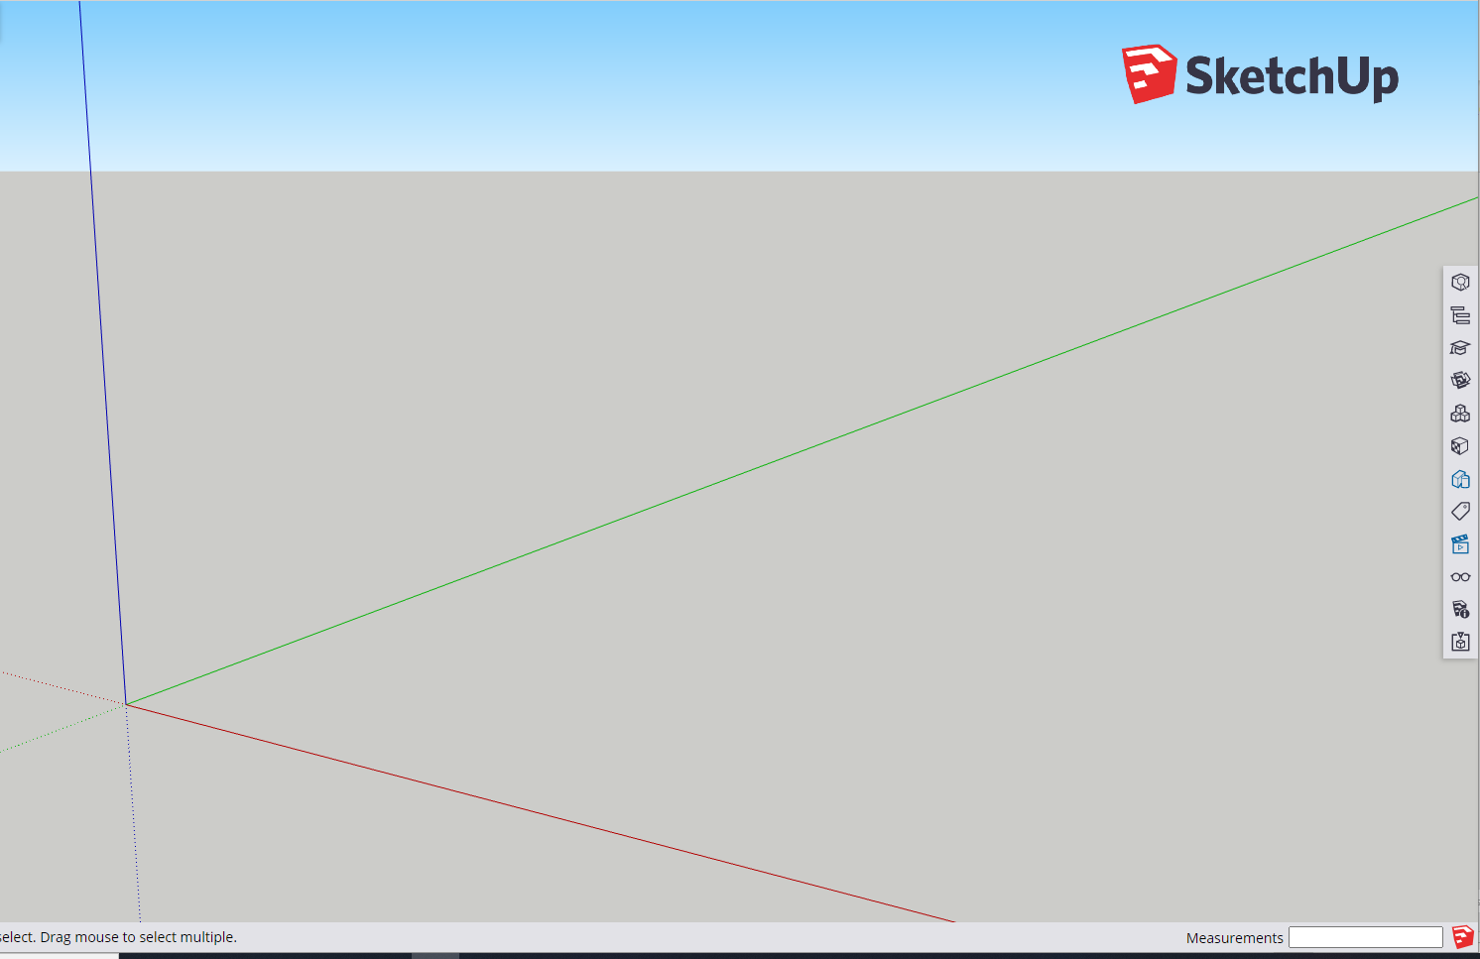

Workspace Organization
WORKSPACE
Select objects. Shift to extend select. Drag mouse to select multiple.
8 X20

Slide 3
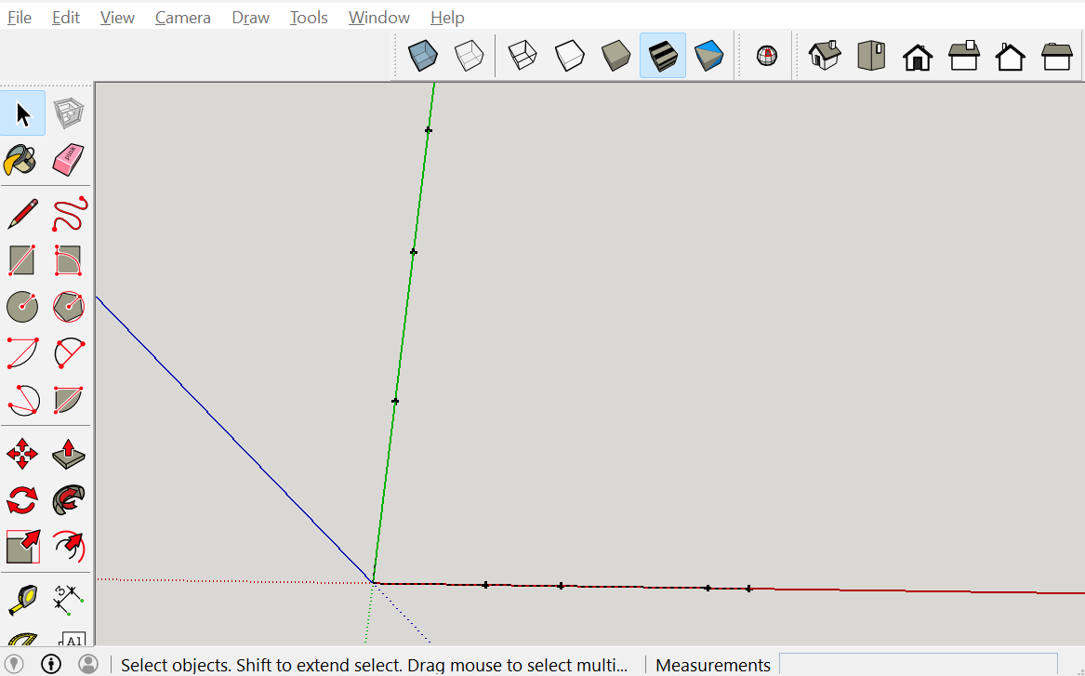

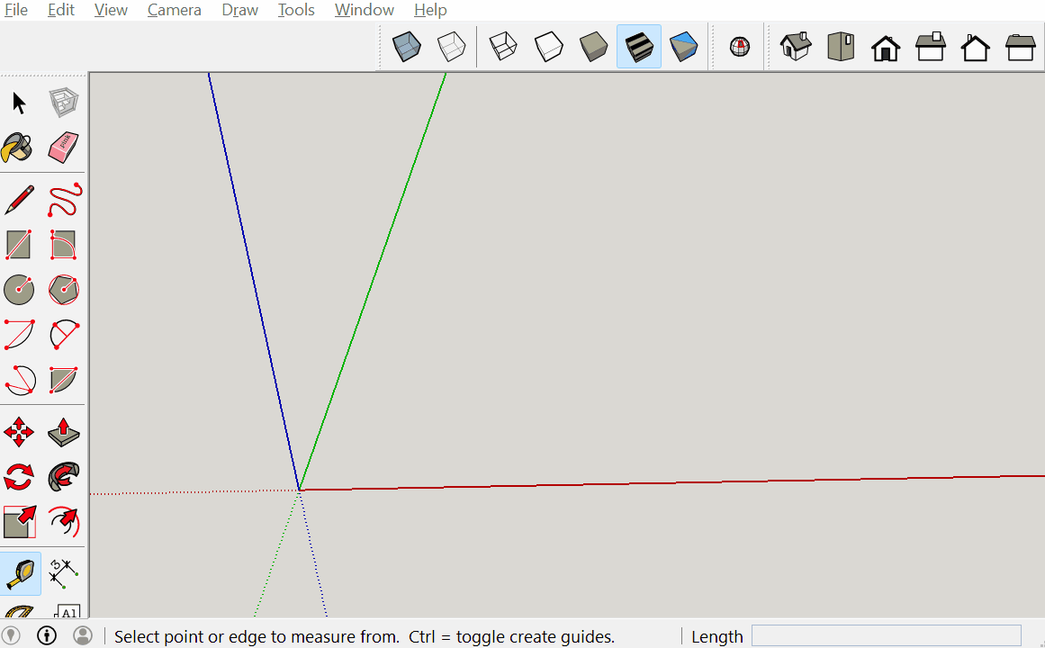
Carabiner Modeling
Use the tape measure tool create guide points at 15mm, 25mm, 44.5mm and 50mm from the origin, on the red axis.
Next make guide points at 26.5mm, 52.5mm and 77.5mm from the origin on the green axis.
1

Slide 4
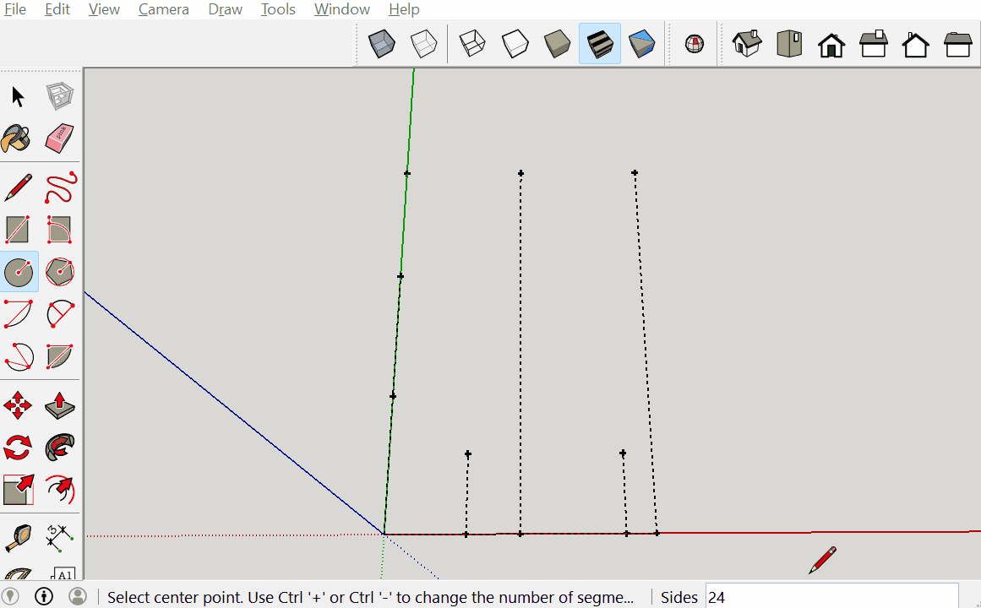
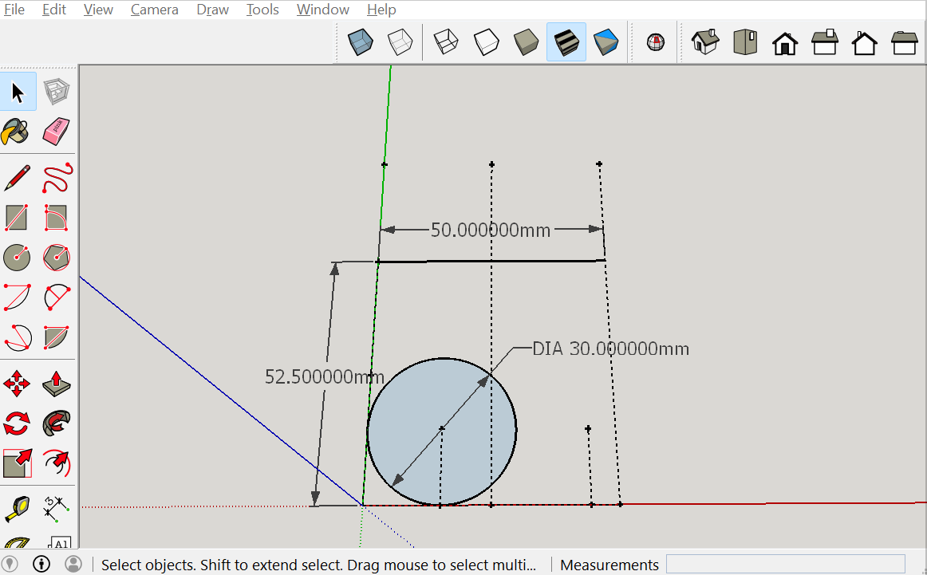
Carabiner Modeling
Then use the circle tool to create a circle with radius 15mm at the 15mm by 15mm mark. Change the number of segments to 60. (Use entity info.)
Then create a line from the middle mark on the green axis across 50mm parallel to the red axis.
3

Slide 5
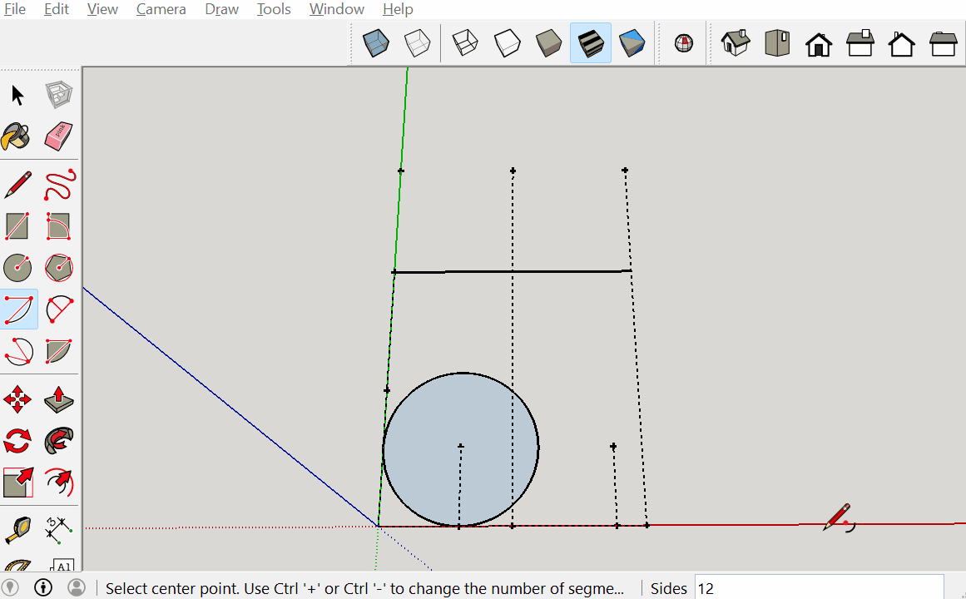

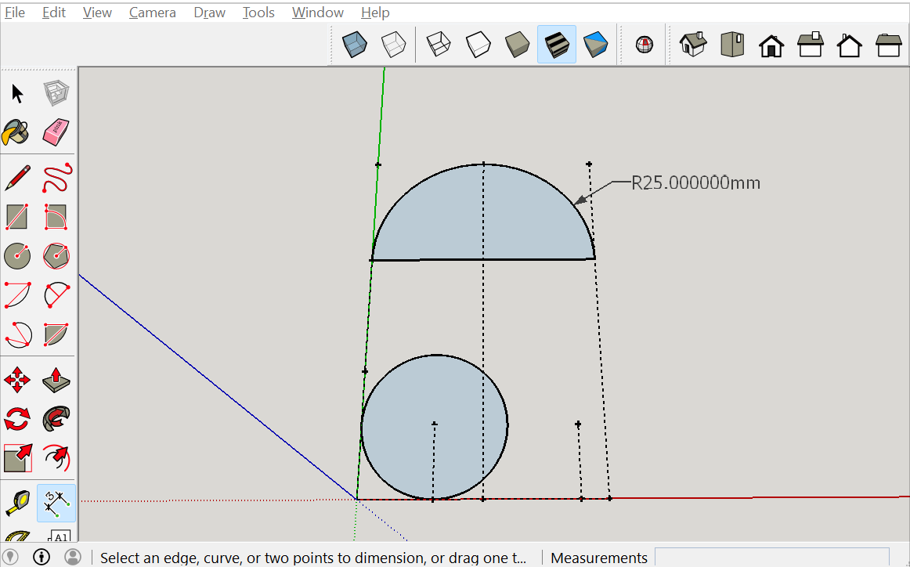
Carabiner Modeling
Then use the midpoint of the line we created as the center. After clicking the midpoint, click the left end of the line, and then click the right end of the line. Then change the number of segments to 30.
4

Slide 6
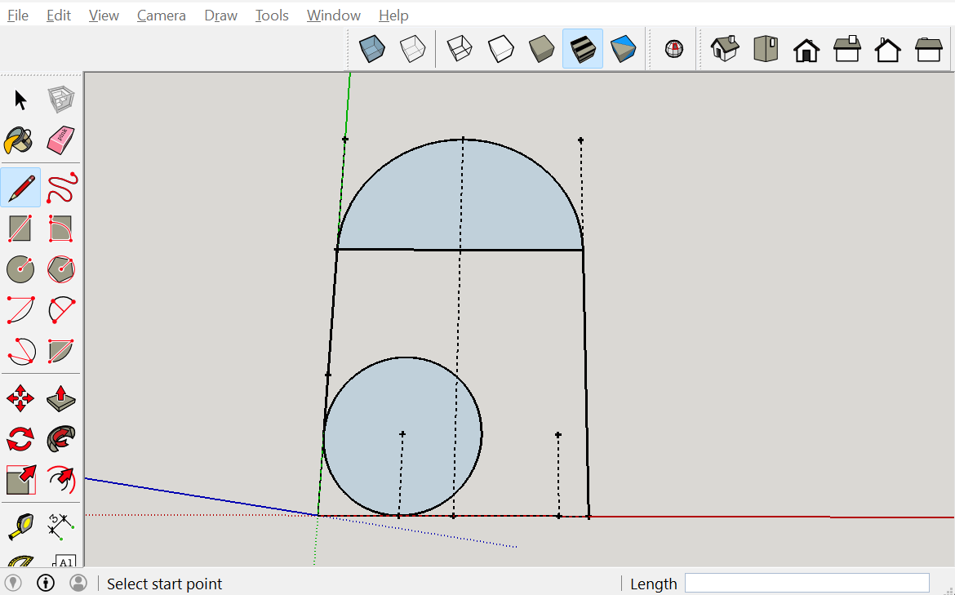
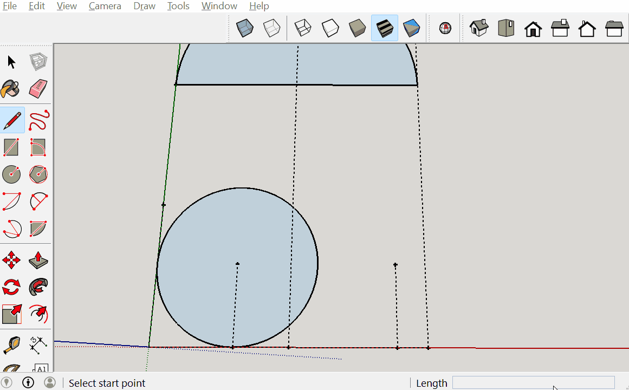
Carabiner Modeling
Then draw a line starting tangent to the circle on the green axis up to the beginning of the arc.
Then draw another line going down from the right side of the arc all the way to the green axis.
5

Slide 7
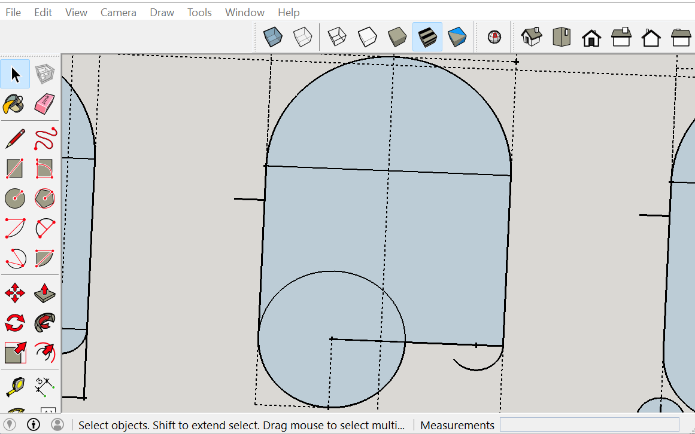
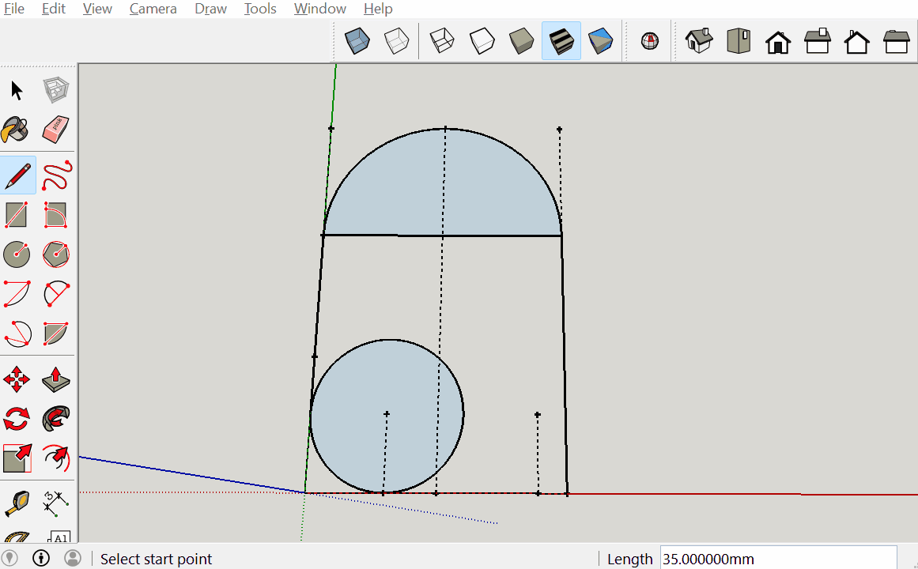
Carabiner Modeling
Draw a line from the center of the circle, all the way to the line on the right.
Then draw an arc from the point on the line with an angle of 135.
6

Slide 8
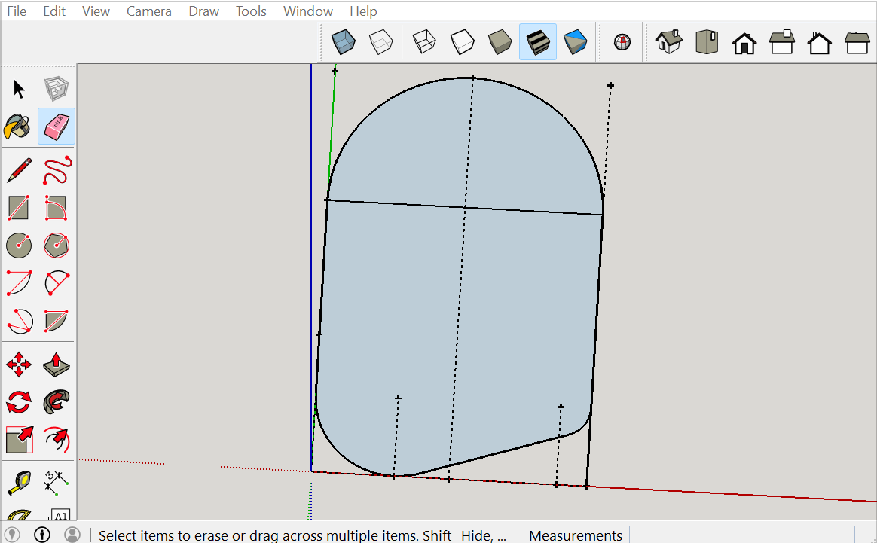
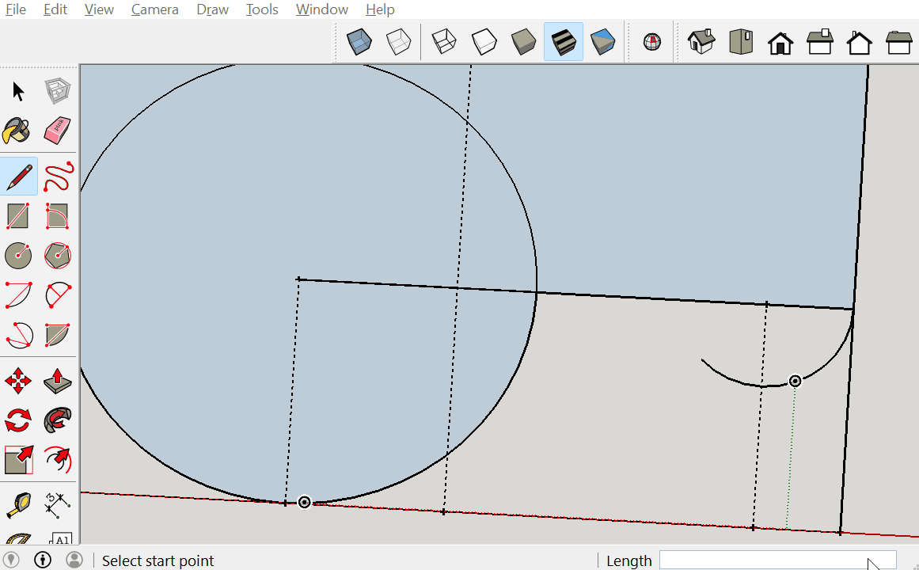

Carabiner Modeling
Then draw a line to connect the bottom-most part of the newly created arc with the circle.
Then using the eraser tool remove all unnecessary lines.
7

Slide 9
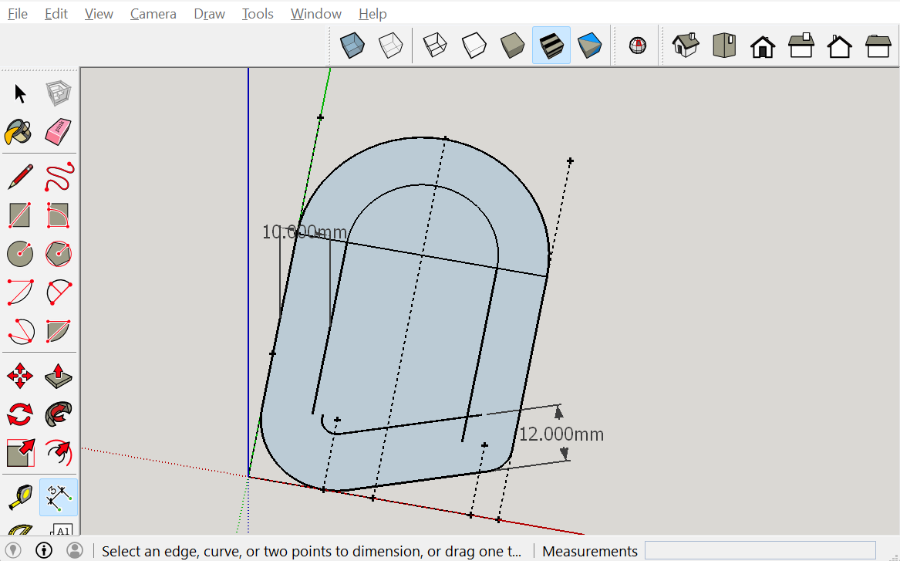
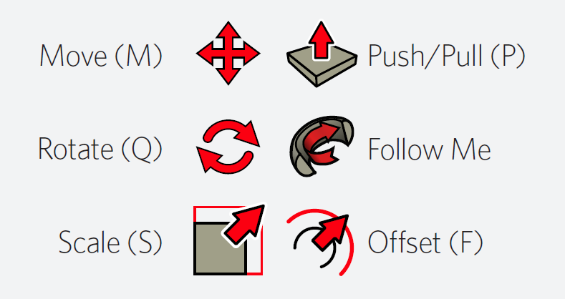
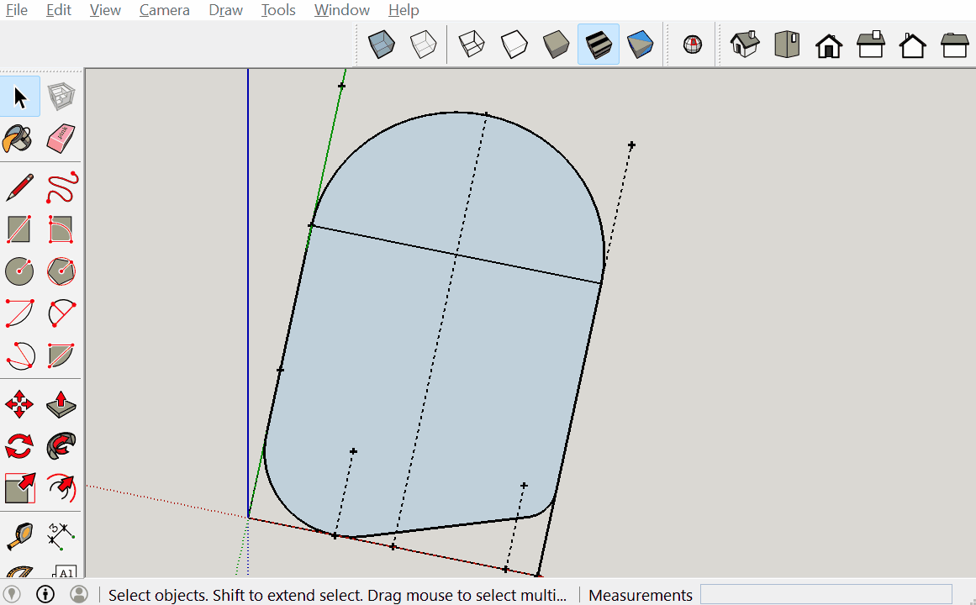
Carabiner Modeling
c
Then select the top arc, and the two vertical lines, and use the offset tool and offset it 10mm.
Then take the remaining lines and offset those 12mm.
8

Slide 10
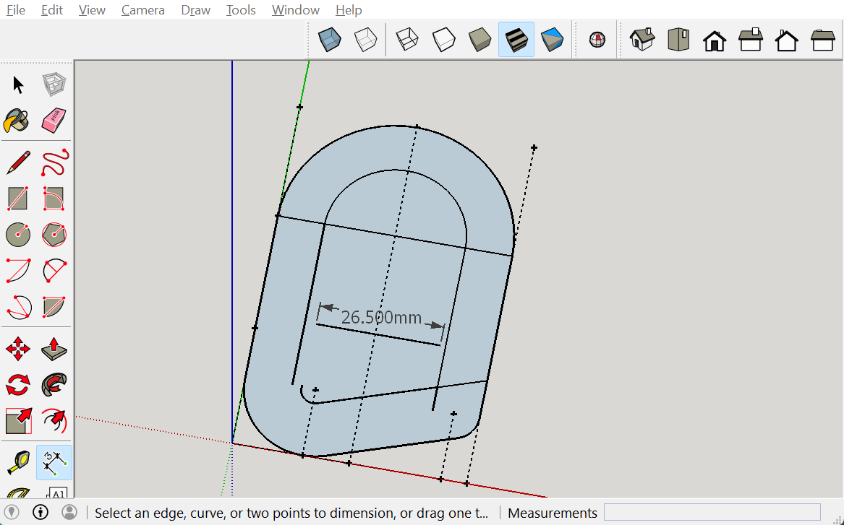
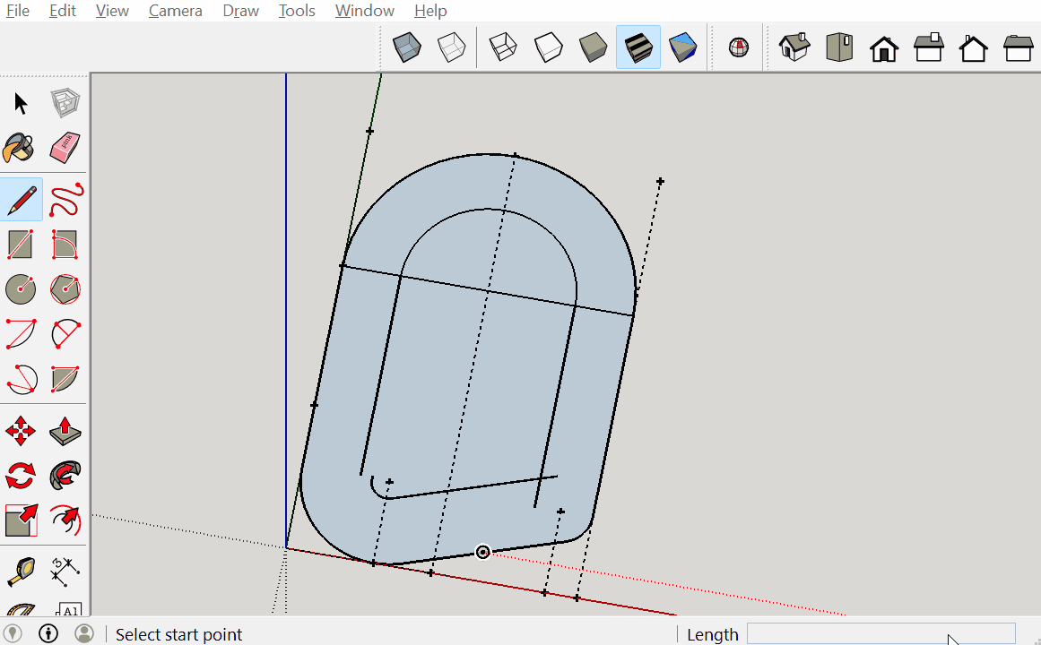
Carabiner Modeling
Then extend the 12mm offset to the furthest right horizontal line.
Then create a line that is 26.5mm and parallel to the red axis in the middle of the surface (make sure it doesn’t touch any other lines).
9

Slide 11
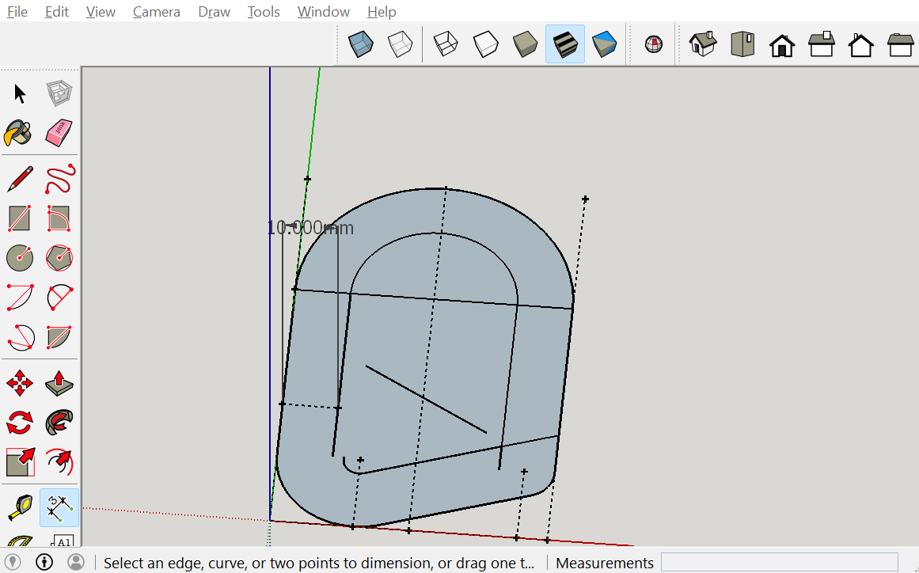

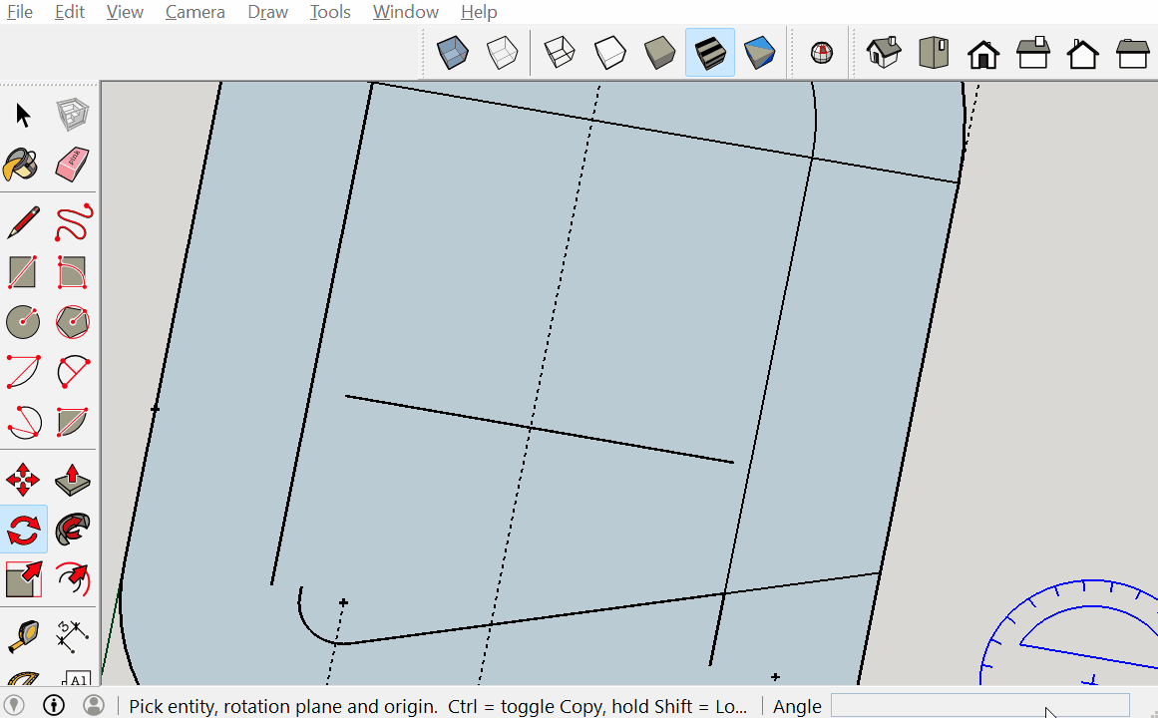
Carabiner Modeling
Then use the rotate tool and select the midpoint of the line and rotate it 30 degrees downwards.
Then use the unused mark on the green axis and measure out 10mm to the right of it.
10

Slide 12
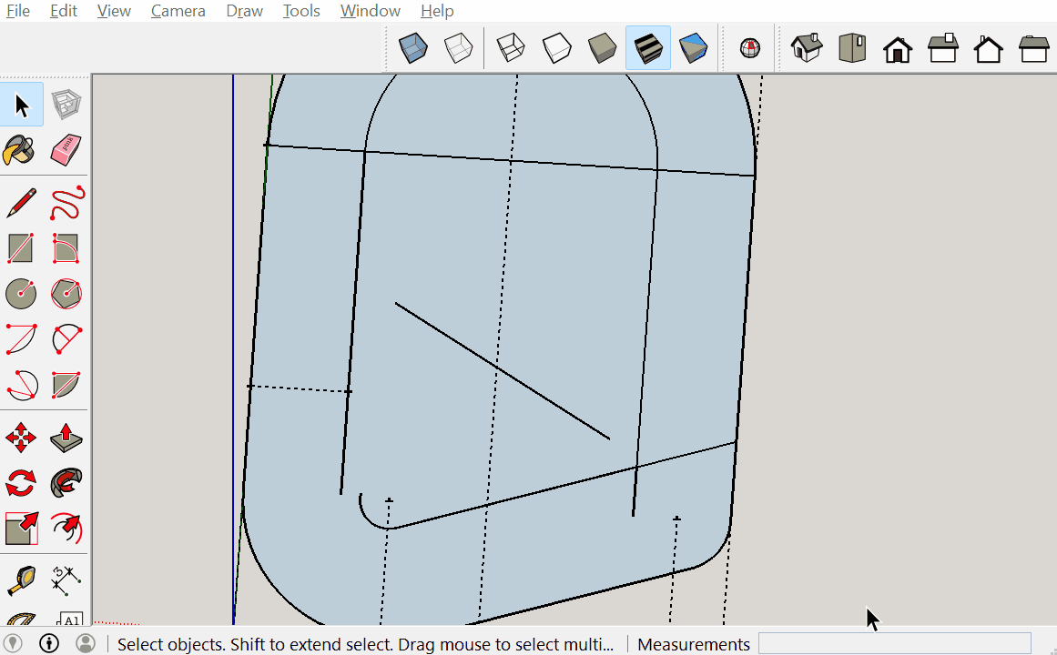
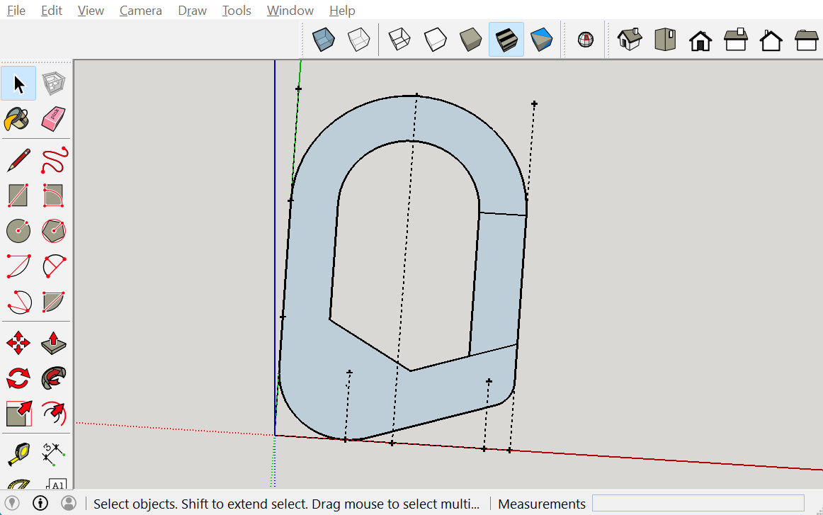
Carabiner Modeling
Then select the line and use the move tool to move it to the point intersected on the offset.
Then use the eraser tool to remove unnecessary lines.
11

Slide 13
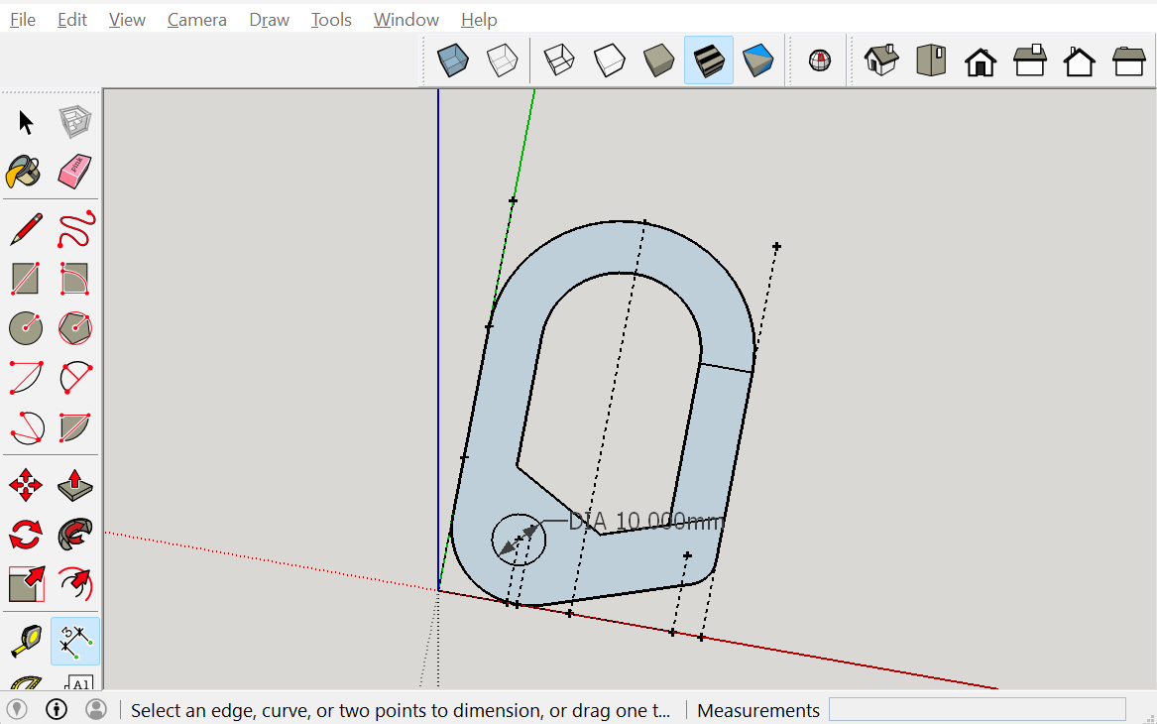
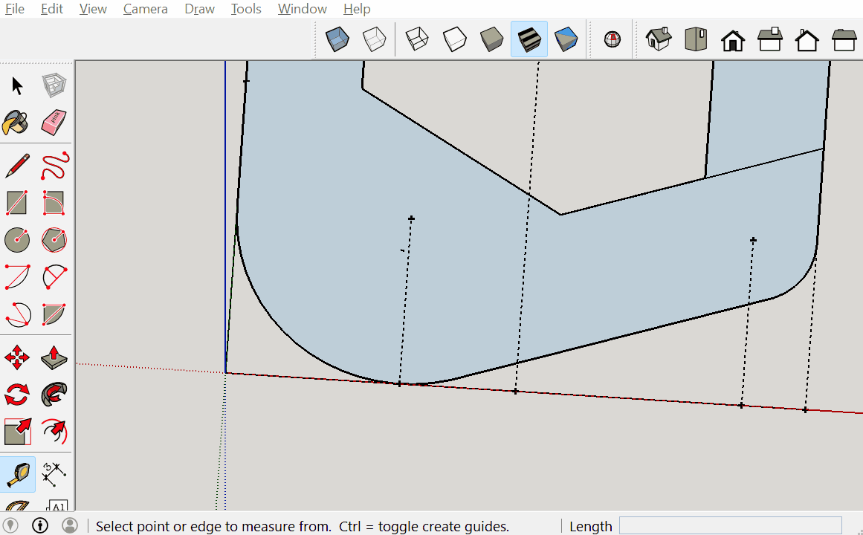
Carabiner Modeling
Use the tape measure tool to measure 13mm from the origin on the red axis. Then measure up 12.5mm.
At last guide point you just made., create a circle with radius 5mm. Change the number of segments to 60.
12

Slide 14
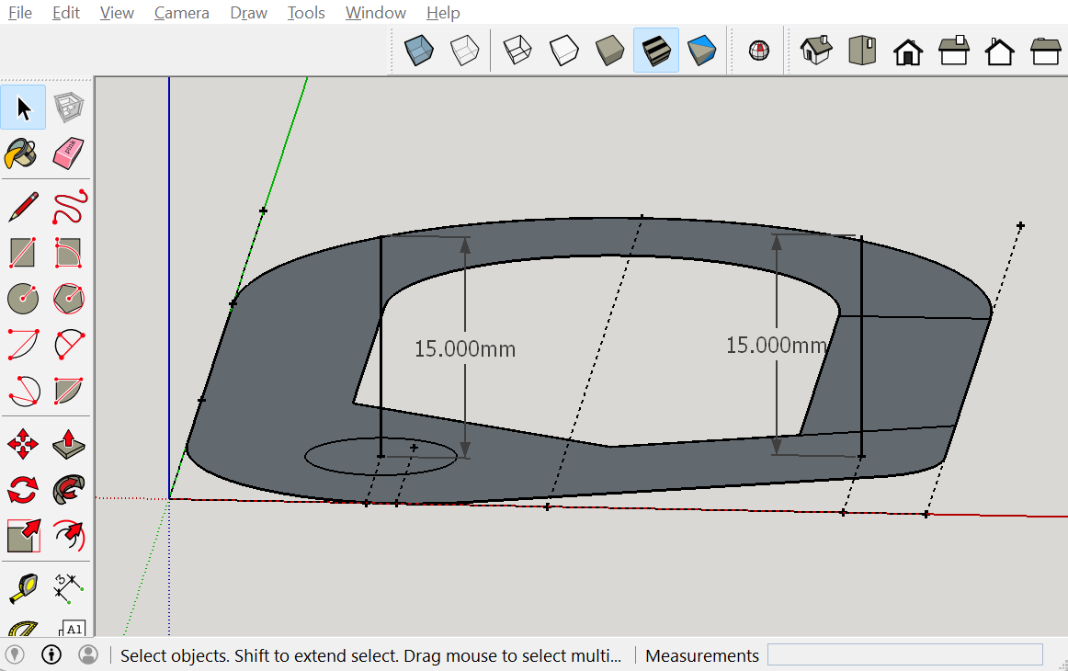
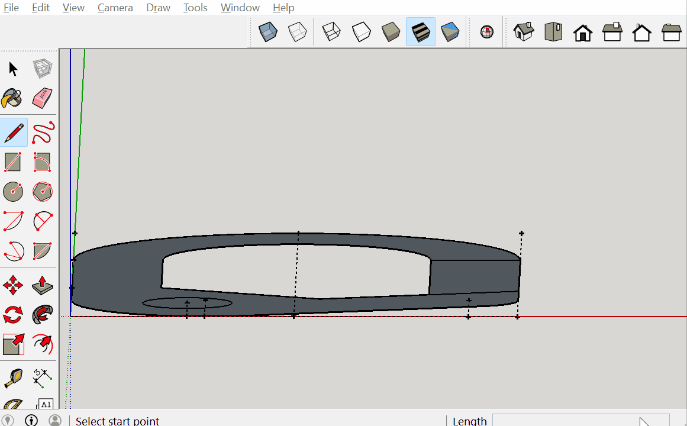
Carabiner Modeling
Then at the center point of the circle just made, draw a 15mm line parallel to the blue axis.
Then do the same at the tape measured point on the right side of the sketch.
13

Slide 15
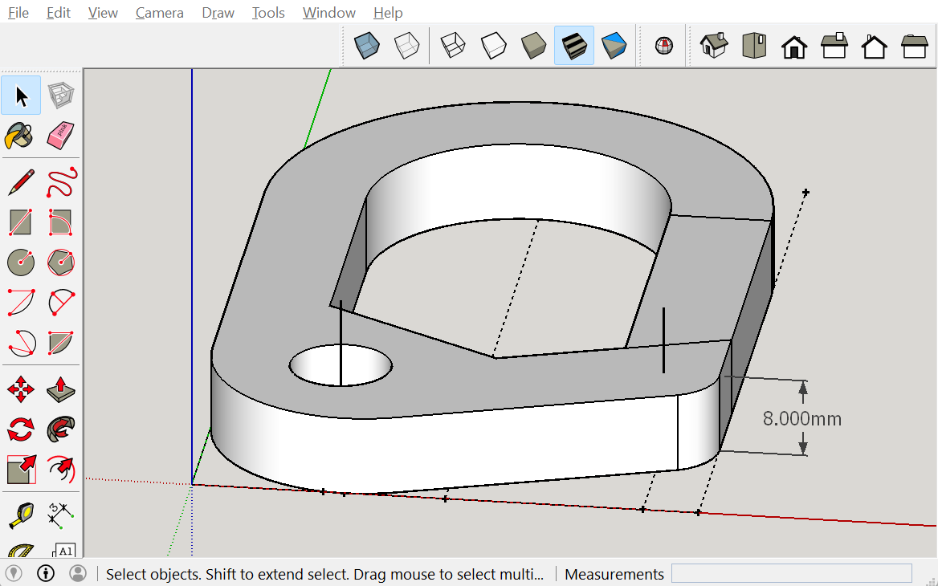

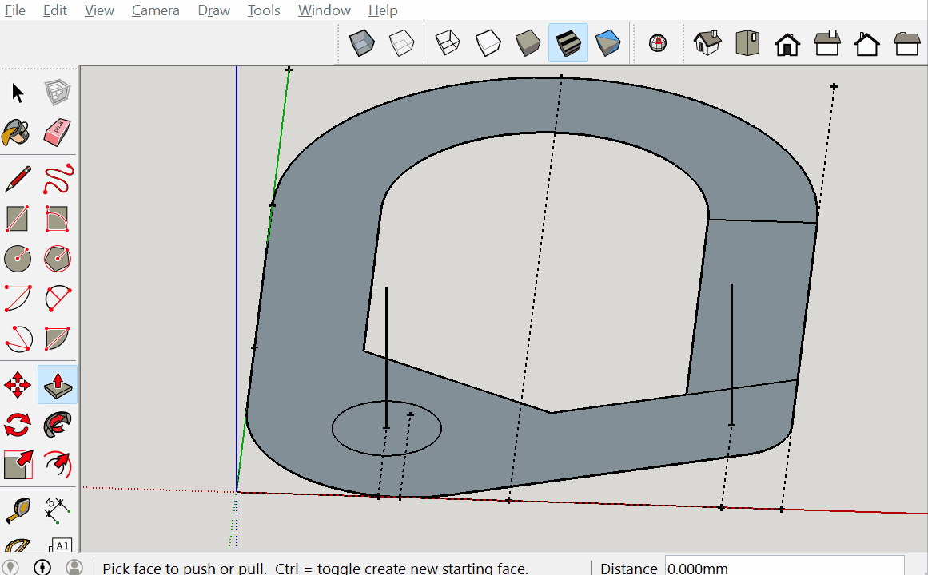
Carabiner Modeling
Then using the push pull tool, pull the surface up 8mm.
14

Slide 16
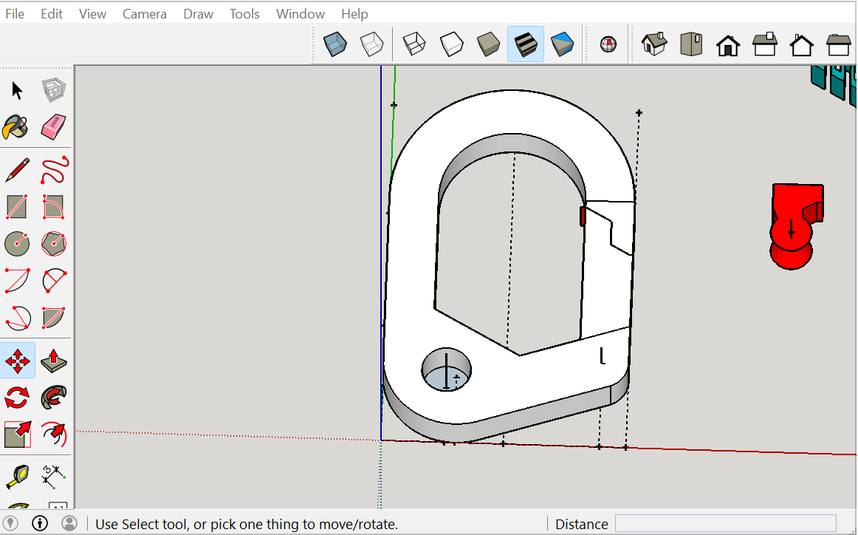
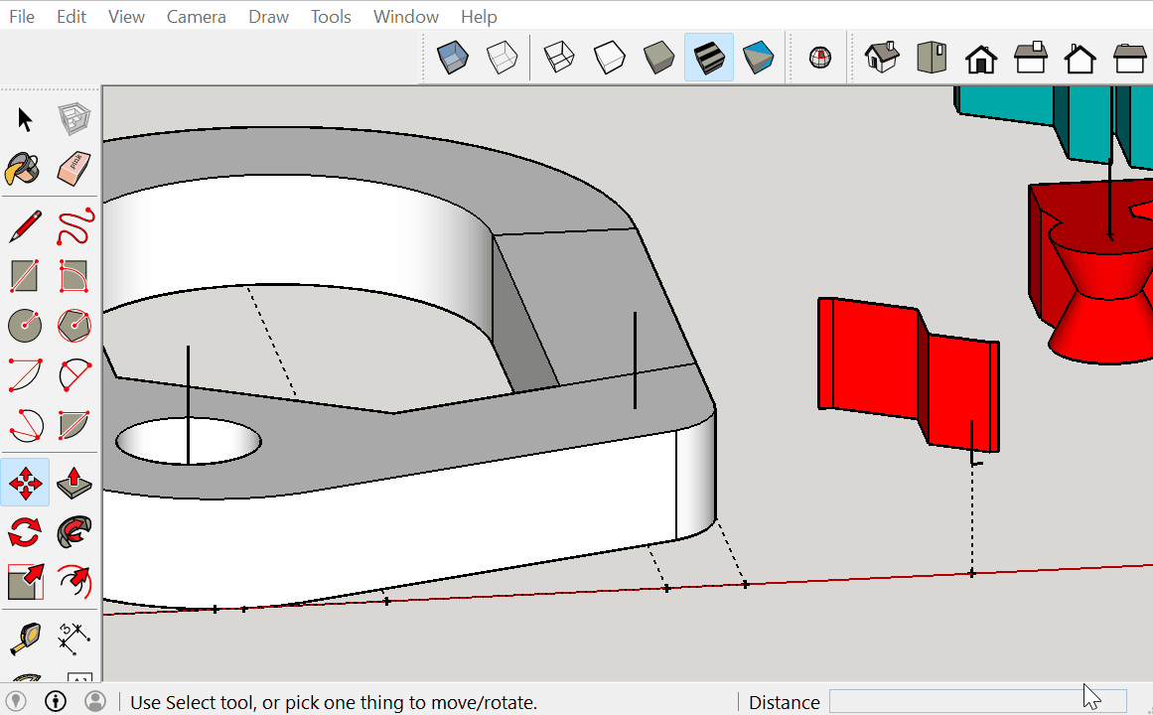
Carabiner Modeling
Then insert the cutter by copying and pasting the group. Then take the bottom end of the stray line and use that point to move it to the bottom of the extending line coming out of the face of the carabiner.
15

Slide 17
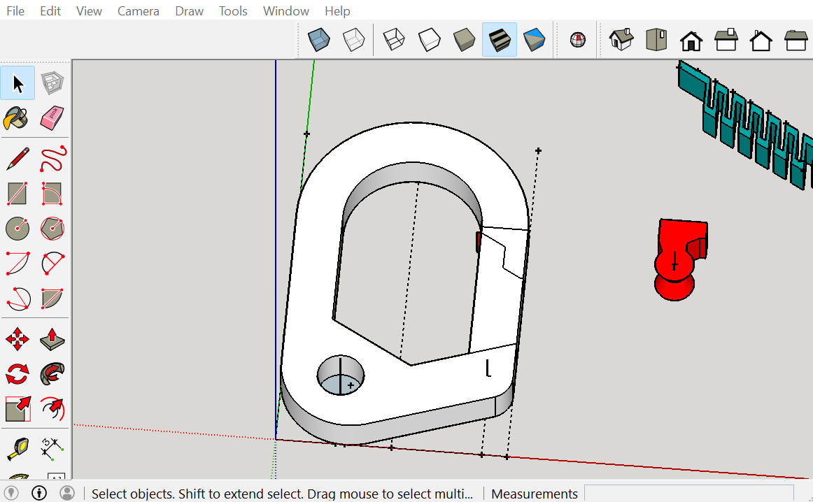
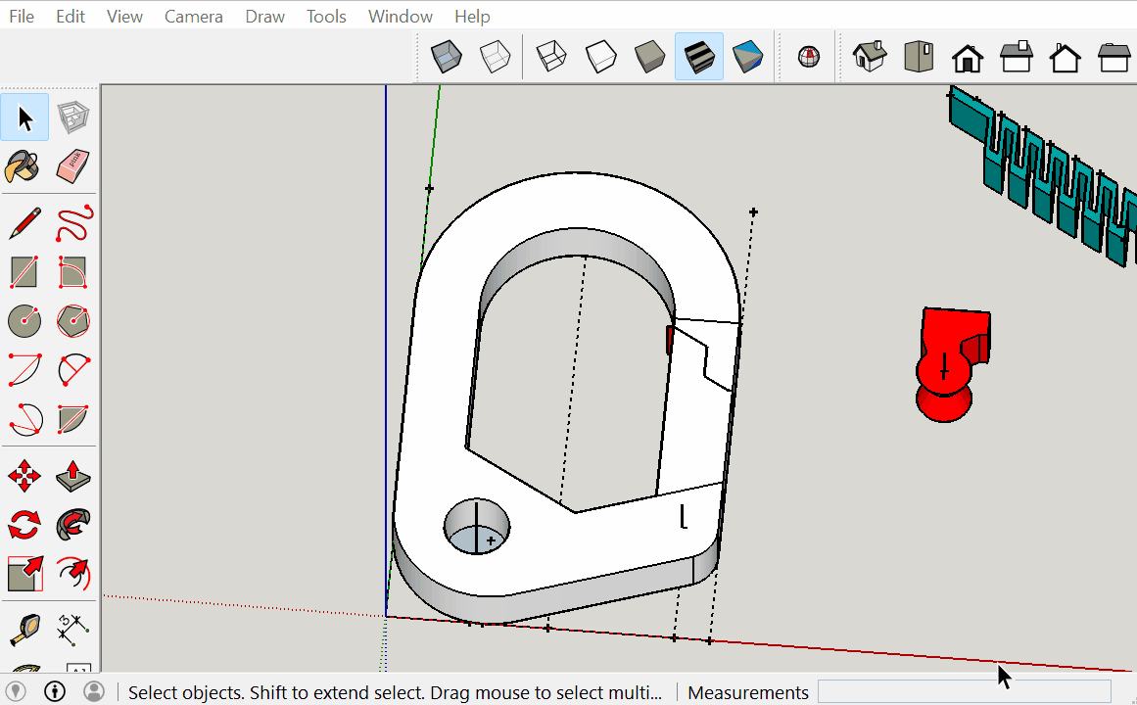
Carabiner Modeling
Select the entire object, right click and intersect faces with selection.
Then select the entire carabiner, and right click and explode.
16

Slide 18
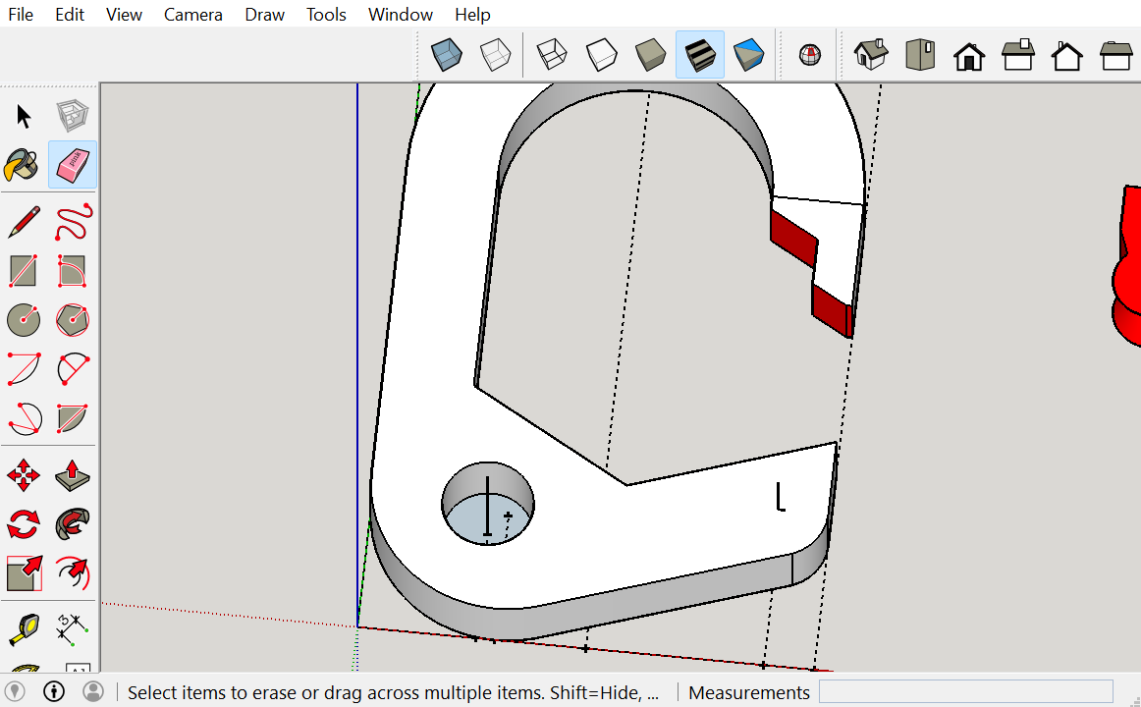
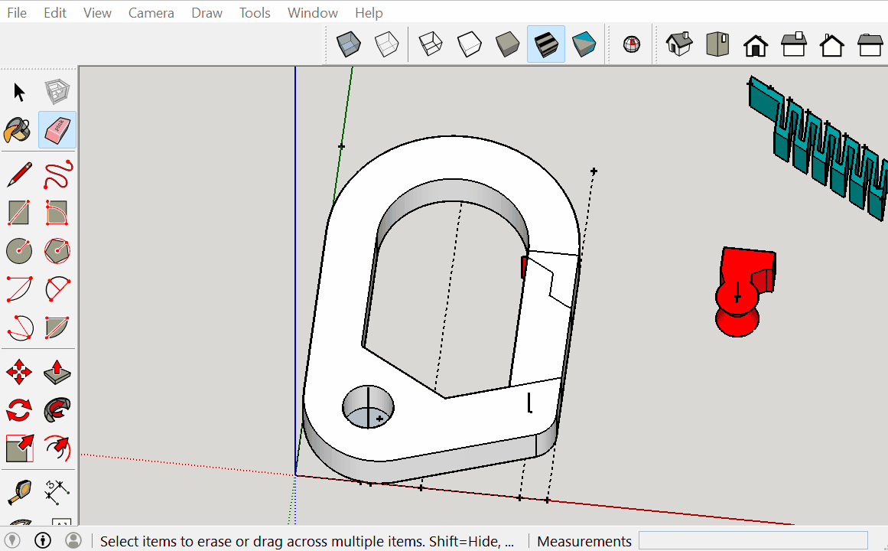
Carabiner Modeling
Then remove the unnecessary faces and lines in the center of the cutter area.
17

Slide 19
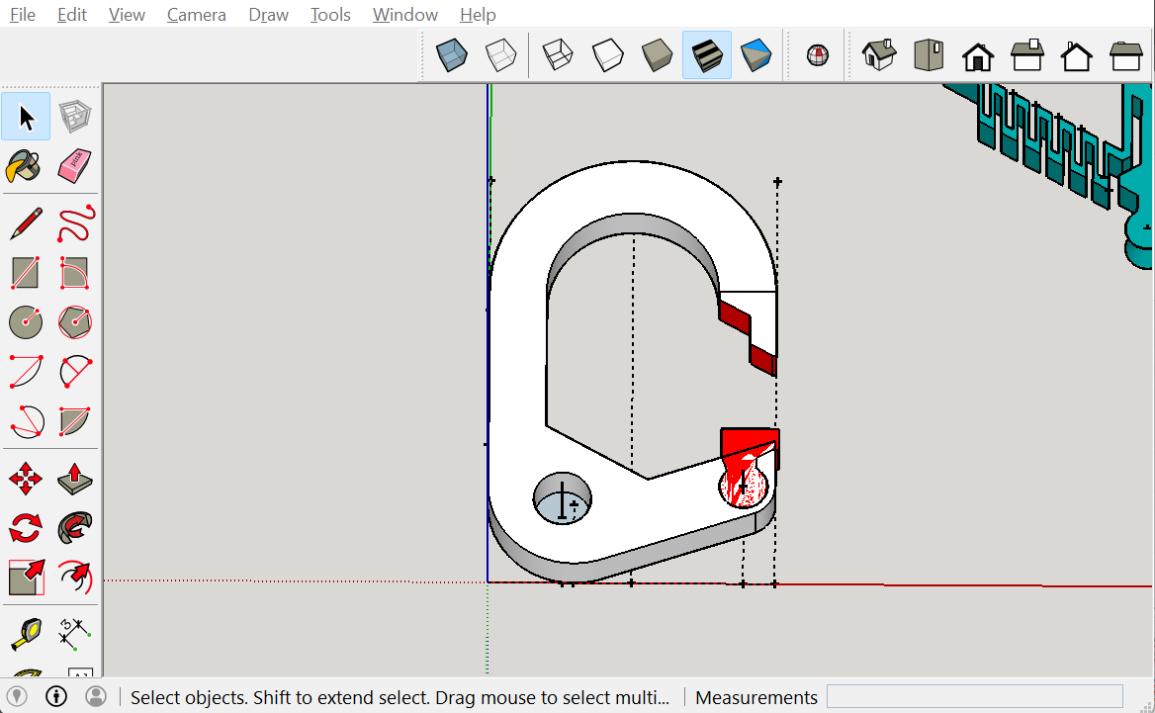
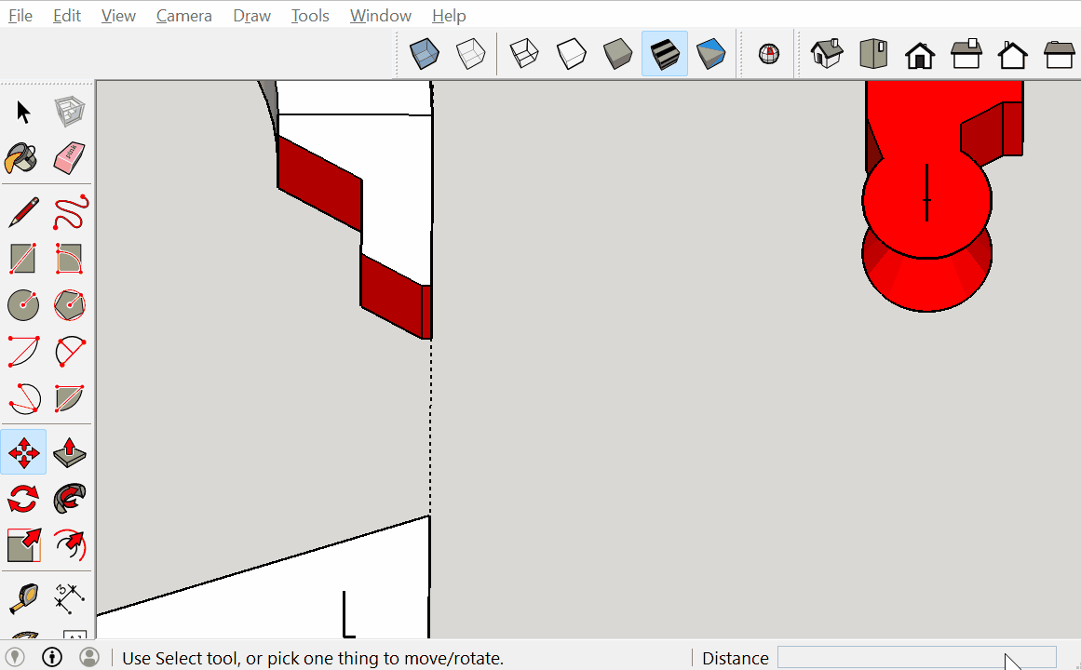
Carabiner Modeling
Use the center of the cutter to move the object to the center of the same reference point.
Then select everything and right click intersect faces.
18

Slide 20
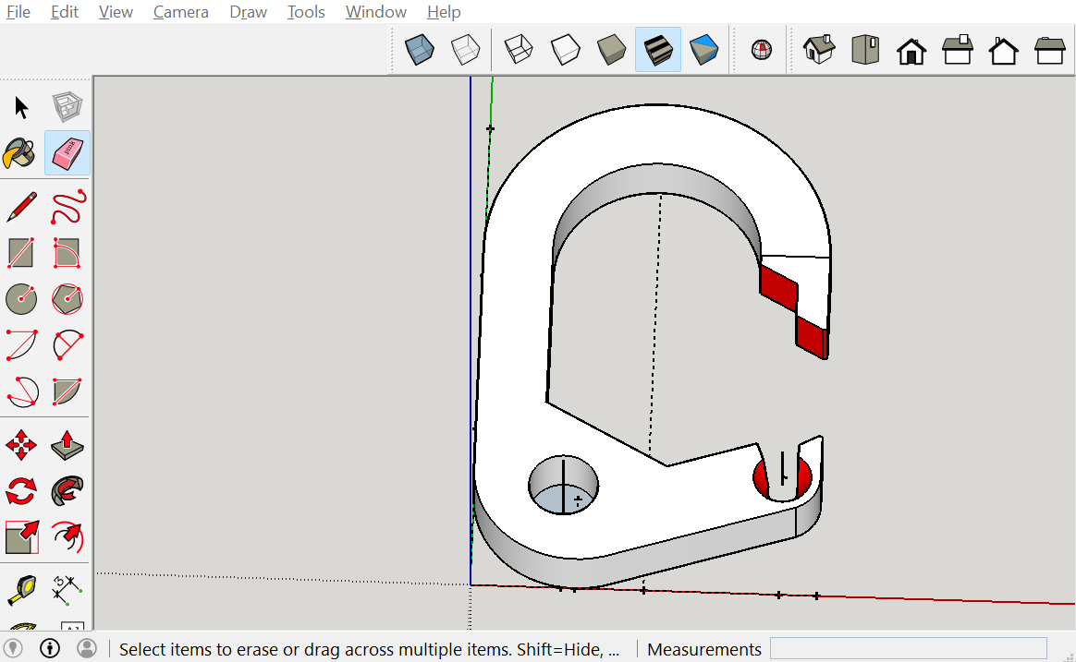
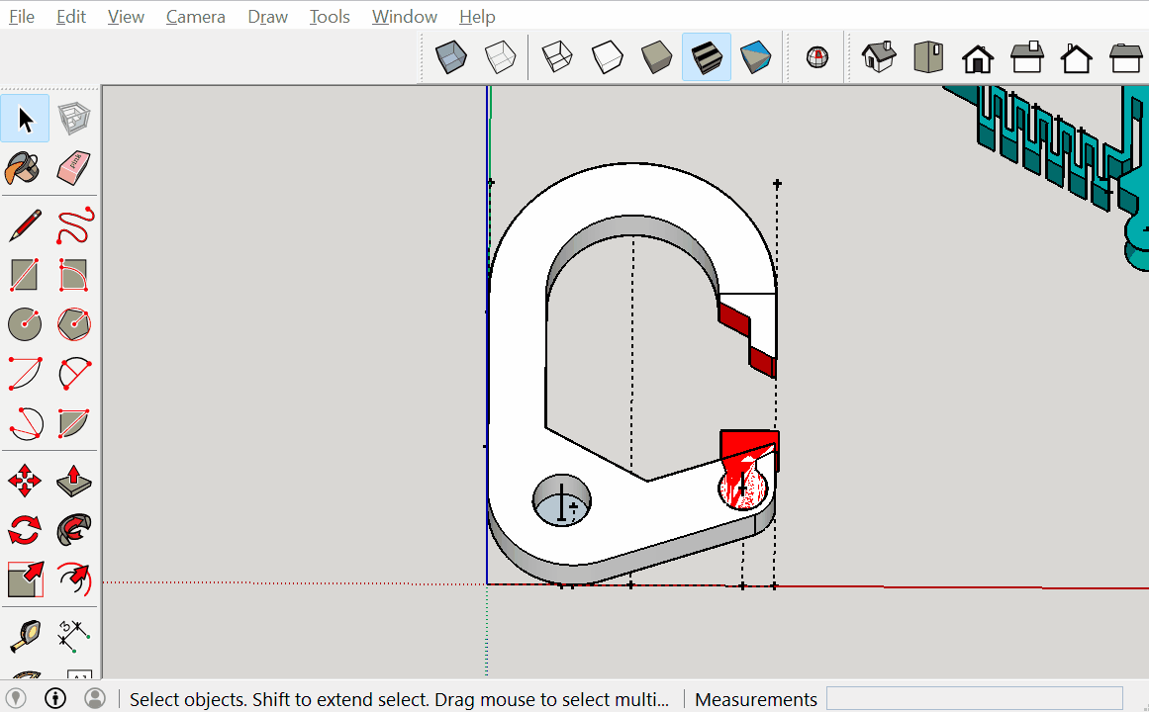
Carabiner Modeling
Then right click and explode the selection.
Then use the erase tool to remove unnecessary lines and faces.
19

Slide 21
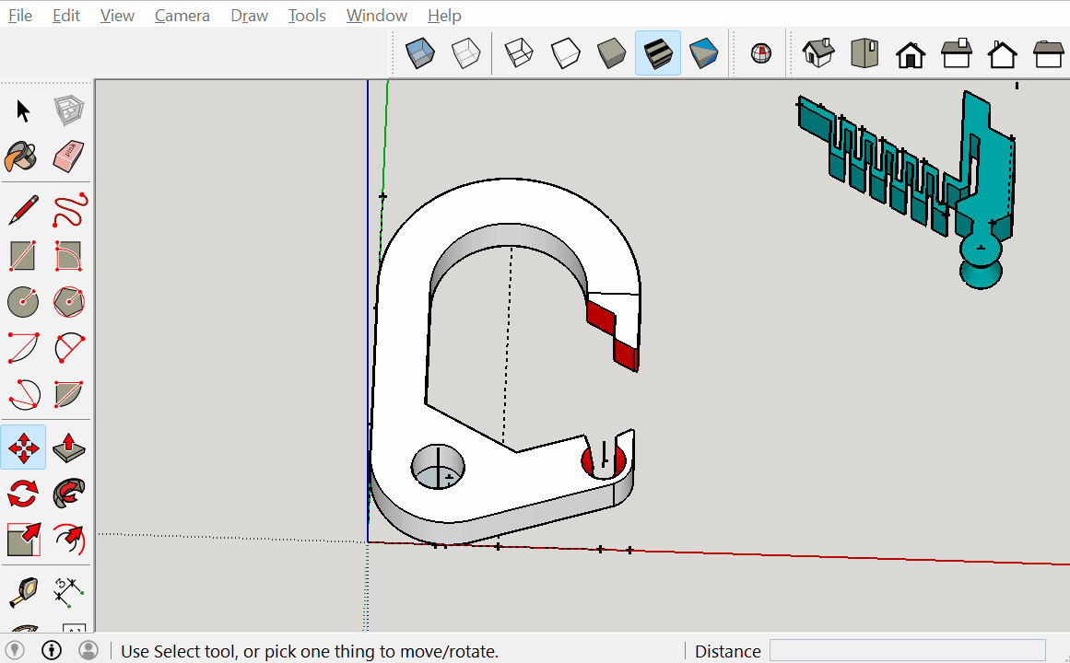
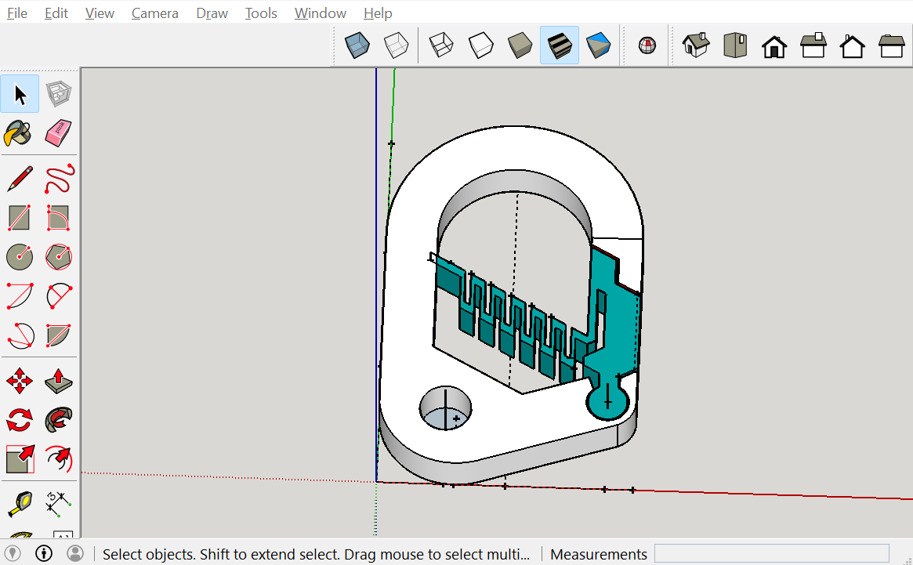
Carabiner Modeling
Finally insert the latch into the project. Then take the center of the circle and move it to the same reference point.
Then select all and right click intersect faces.
20

Slide 22
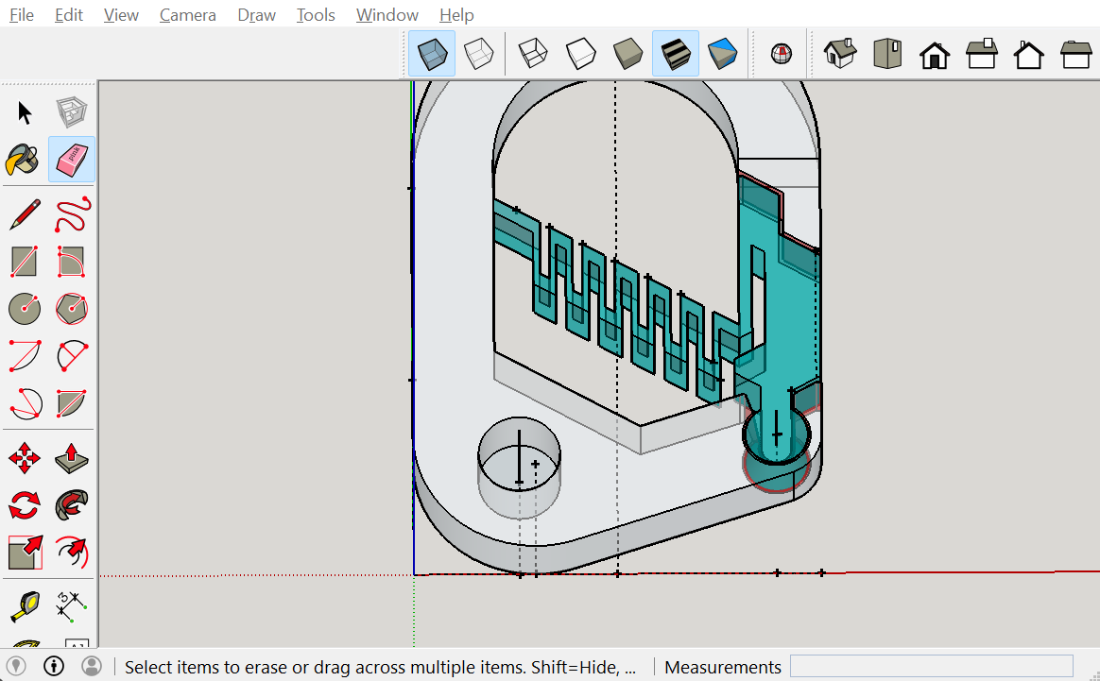
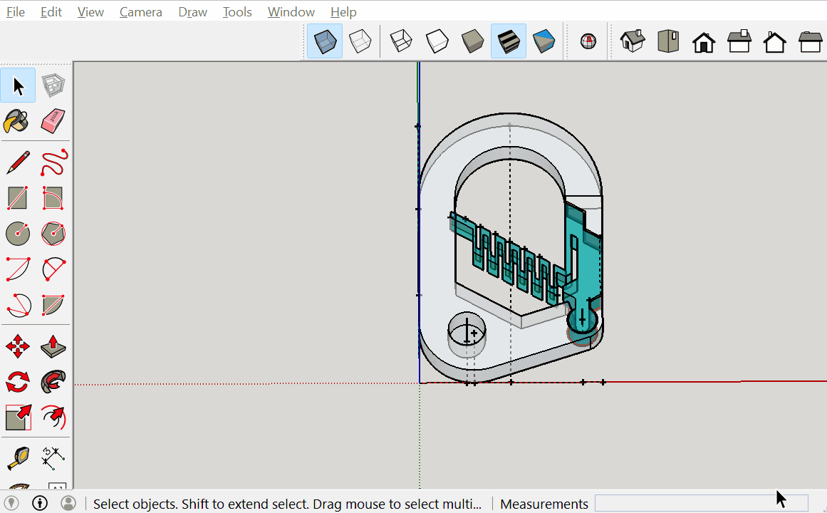
Carabiner Modeling
Select everything and explode it.
Then using x-ray mode remove any interfering materials.
21

Slide 23
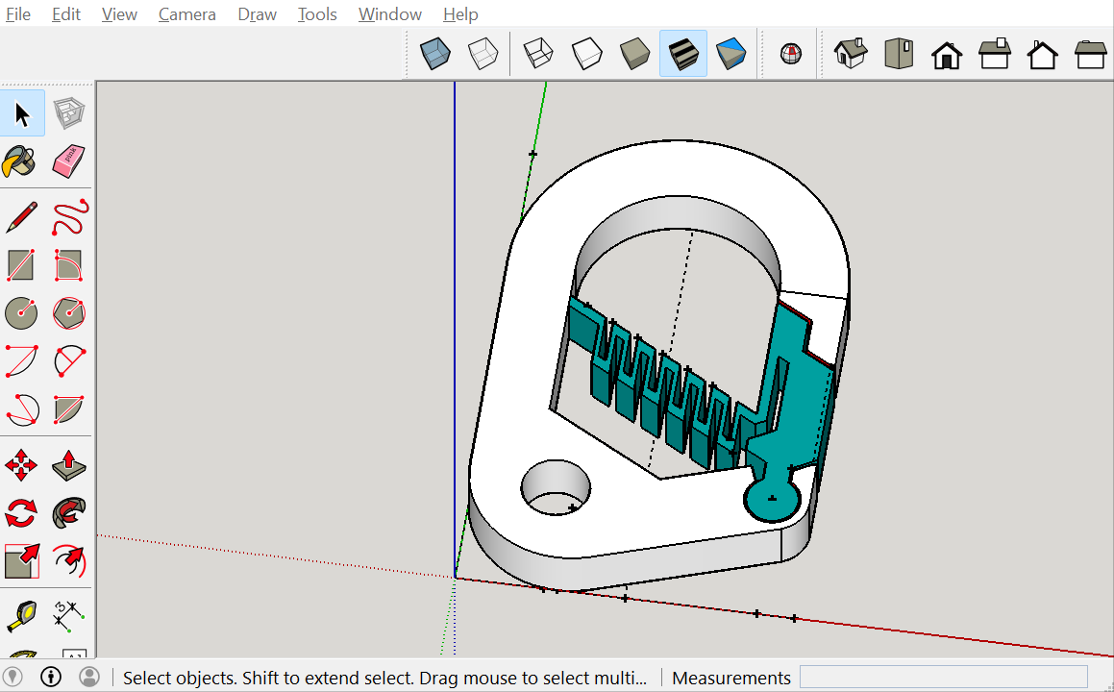

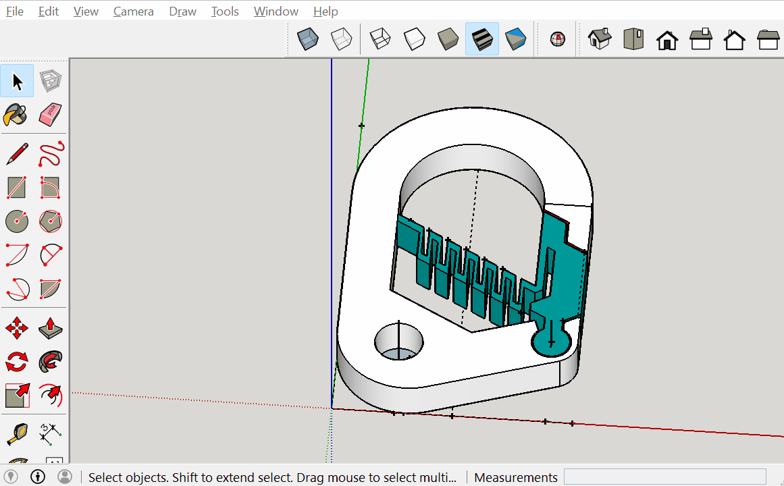
Carabiner Modeling
c
Then check with the solid inspector tool to make sure there are no errors.
22

Slide 24
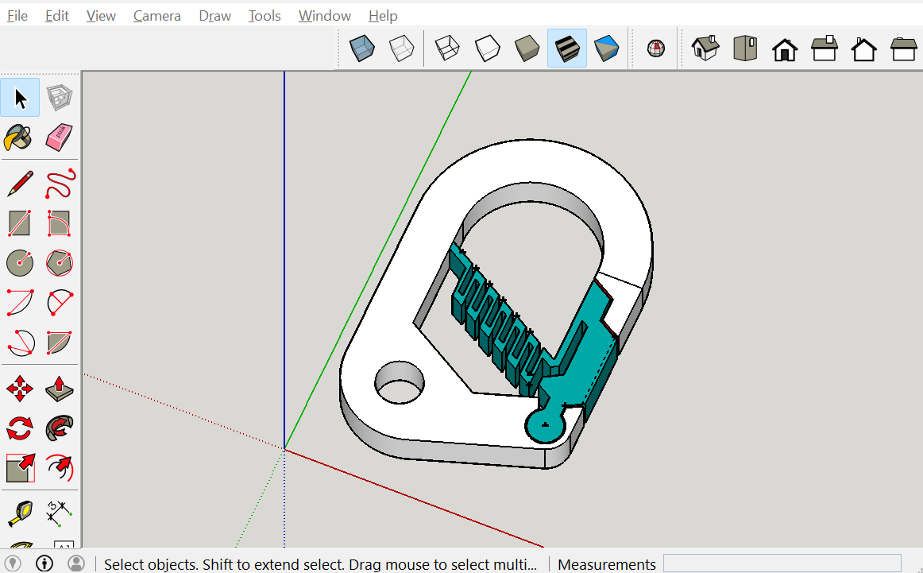
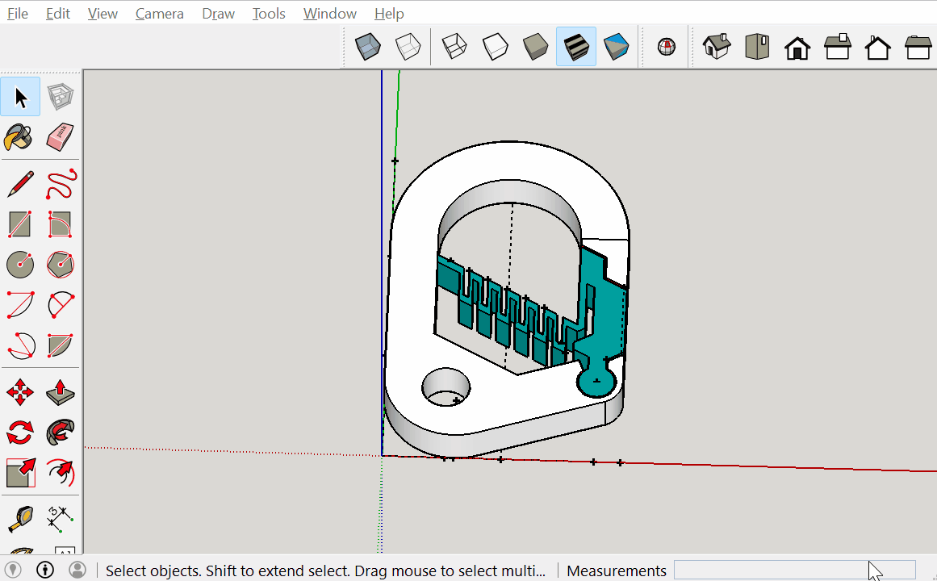
Carabiner Modeling
c
Then highlight everything and make it a group.
Then select the group and scale it by a factor of 0.85.
23

